Slide 1
MONITORING AND MANAGING
LINUX PROCESSES

Slide 2
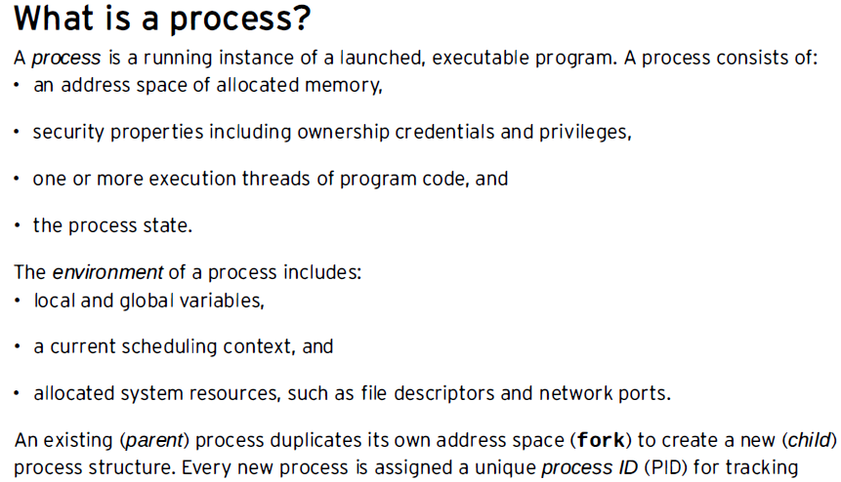
Process

Slide 3
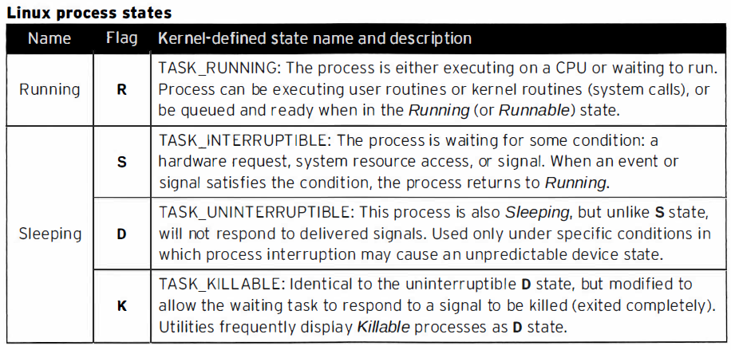

Slide 4
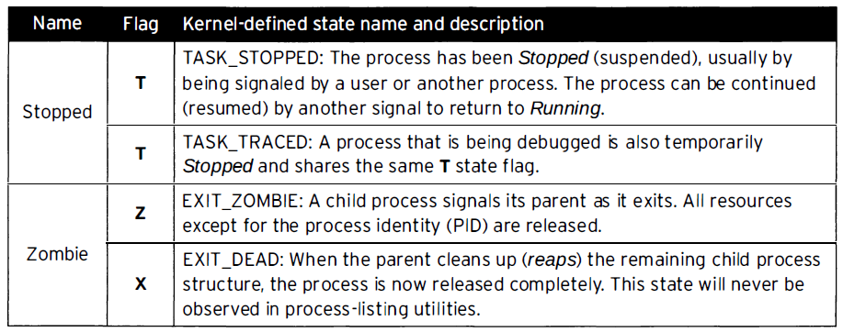
Process States

Slide 5
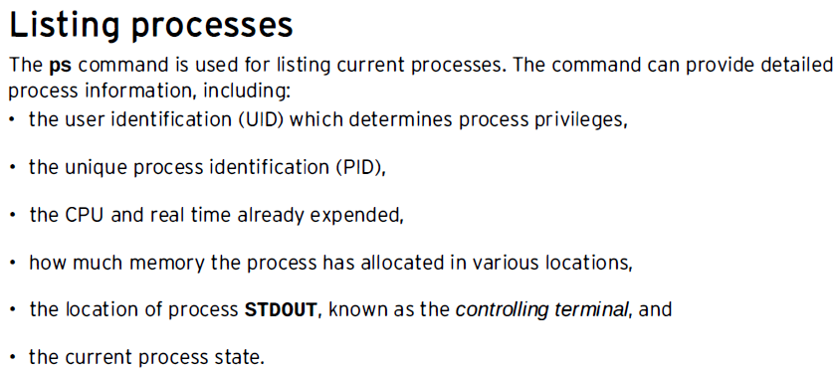

Slide 6
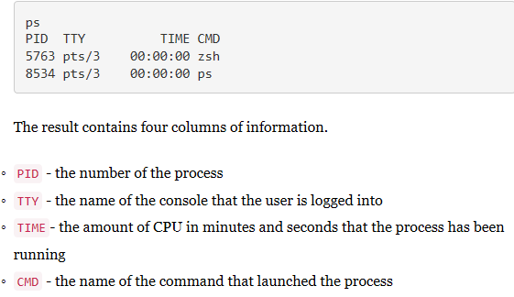

Slide 7
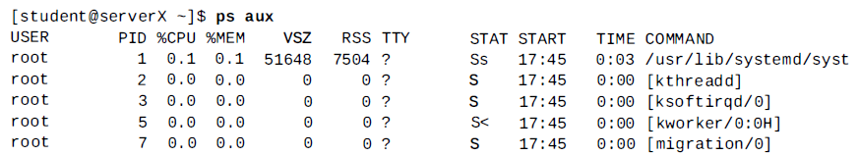
List processes: ps command

Slide 8
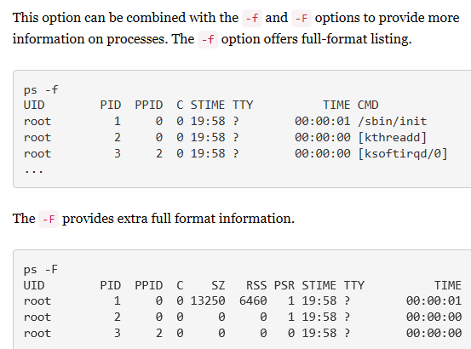
List all processes
To list all processes on a system use the -e option.

Slide 9
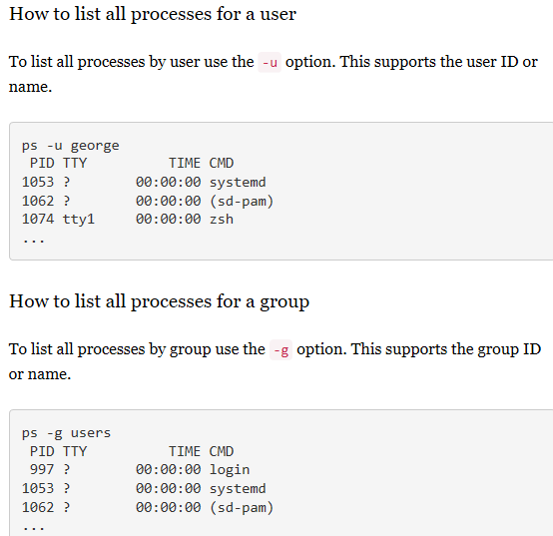

Slide 10
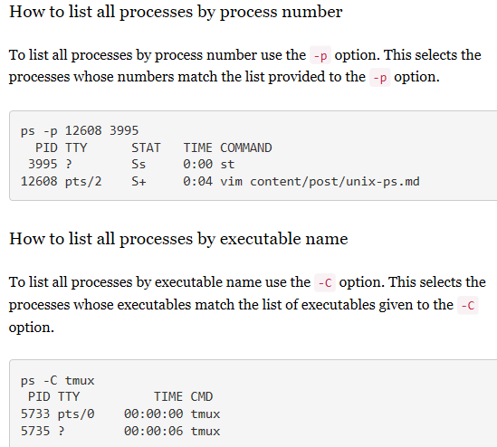

Slide 11
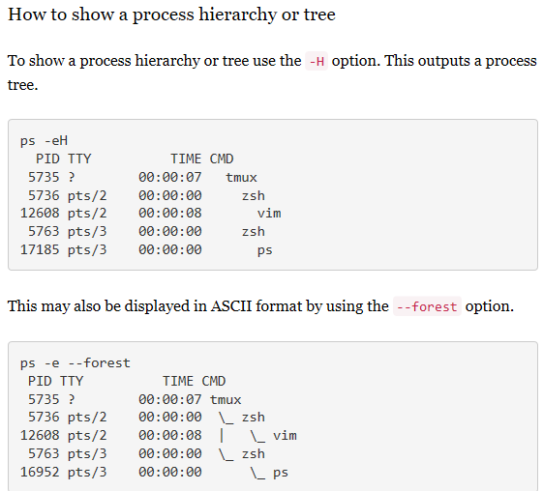

Slide 12
How to only get the process id
  ps command can look for processes by user, group or executable name. The ps can be also be piped to grep to search for arbitrary items.
  ps -ef | grep vim

Slide 13
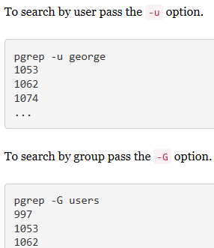

Slide 14
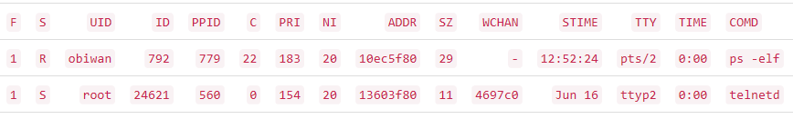
Fields displayed by ps command

Slide 15
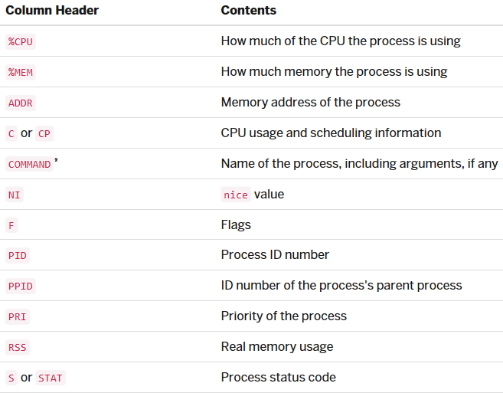

Slide 16
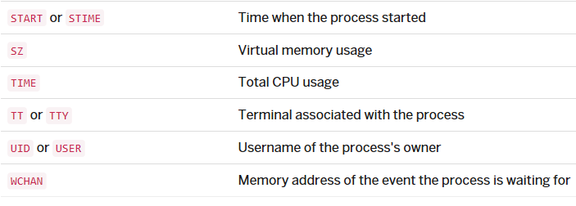

Slide 17
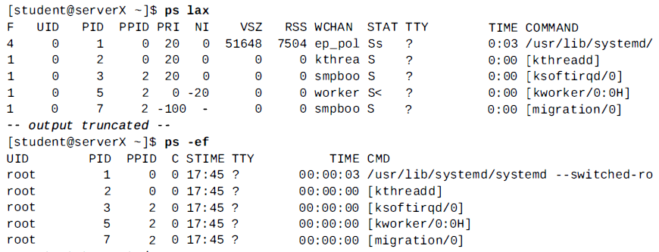
ps command options

Slide 18
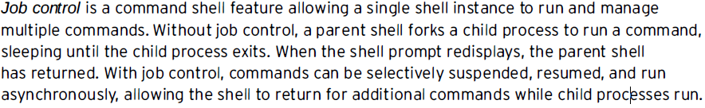
Jobs and sessions

Slide 19
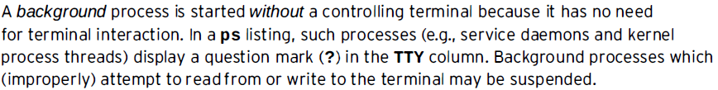
Jobs and sessions

Slide 20
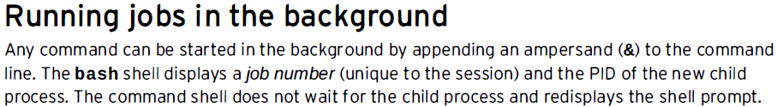



Slide 21
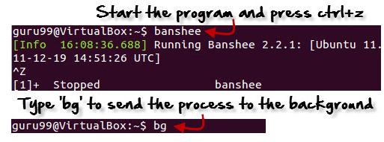
Fg
You can use the command "fg" to continue a program which was stopped and bring it to the foreground.
The simple syntax for this utility is:
fg jobname
Example
Launch 'banshee' music player
Stop it with the 'ctrl +z' command
Continue it with the 'fg' utility.

Slide 22
fg Command
You can use the command "fg" to continue a program which was stopped and bring it to the foreground.
The simple syntax for this utility is:
fg jobname

Slide 23
Top
This utility tells the user about all the running processes
on the Linux machine.

Slide 24
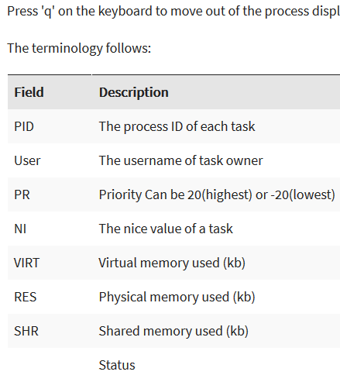

Slide 25
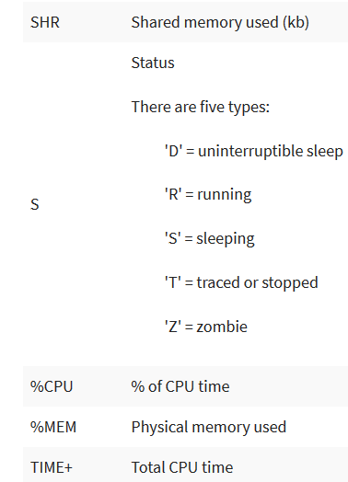

Slide 27
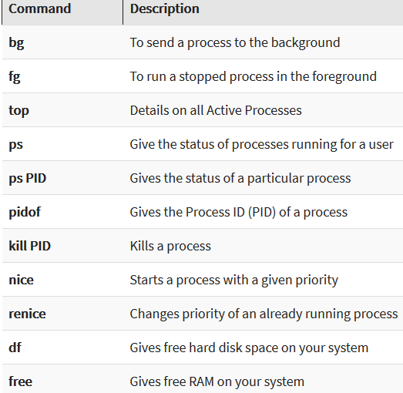

Slide 28
Killing the process
Now we come to the task of killing the process. We have two pieces of information that will help us kill the errant process:
Process name
Process ID
Which you use will determine the command used for termination. There are two commands used to kill a process:
kill – Kill a process by ID
killall – Kill a process by name

Slide 29
Killing the process
There are also different signals that can be sent to both kill commands.
What signal you send will be determined by what results you want from the kill command.
For instance, you can send the HUP (hang up) signal to the kill command, which will effectively restart the process.
This is always a wise choice when you need the process to immediately restart (such as in the case of a daemon).
You can get a list of all the signals that can be sent to the kill command by issuing kill -l.

Slide 30
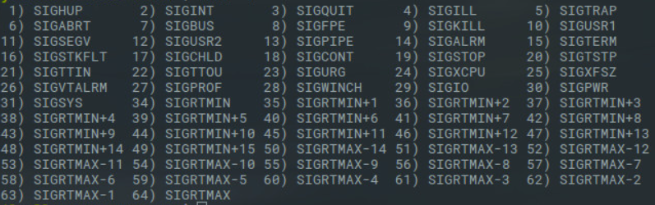
Killing the process

Slide 31
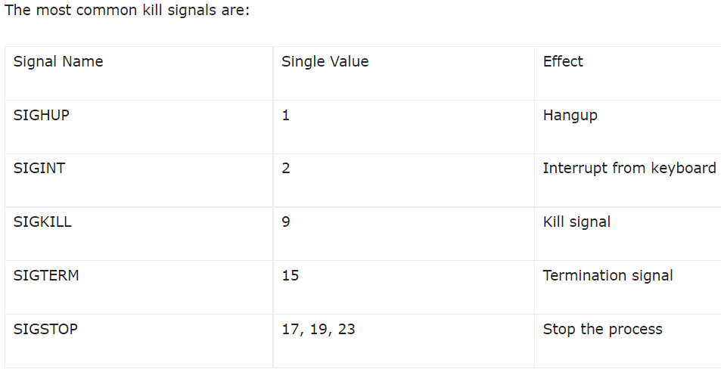
Killing the process

Slide 32
Killing the process
You can use the Signal Value in place of the Signal Name. So you don’t have to memorize all of the names of the various signals.
use the kill command to kill instance of chrome. The structure for this command would be:
kill SIGNAL PID
Where SIGNAL is the signal to be sent and PID is the Process ID to be killed.

Slide 33
Killing the process
To send the kill signal, we’d issue the commands:
kill -9 3827
kill -9 3919
kill -9 10764
kill -9 11679
Once we’ve issued the above commands, all of the chrome processes will have been successfully killed.

Slide 34
Killing the process
If the process to be killed is named chrome, we can make use of the killall command and send the same signal the process like so:
killall -9 chrome
The above command may not catch all of the running chrome processes. If, after running the above command, you issue the ps aux|grep chrome command and see remaining processes running,
better is to go back to the kill command and send signal 9 to terminate the process by PID.

